Slide 1
3-IBFE 3D Flow Past Objects

Slide 2
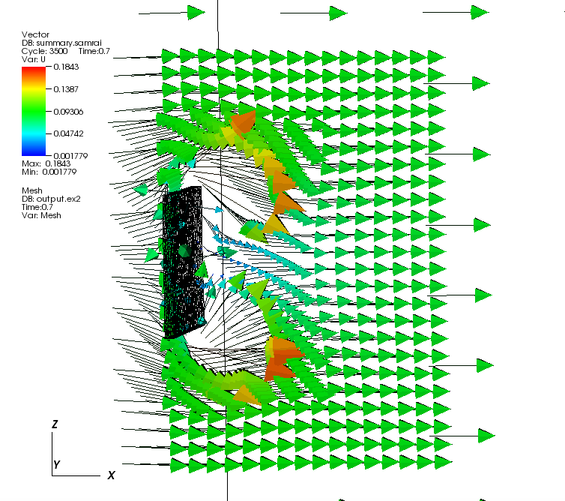
Goal
Create a plate in a 3D flow tank.
Let the plate be tethered along its centerline.
Let the plate have 2 stiffnesses (middle half is different than ends).
Move the flow from left to right along x-axis.
Download here: https://drive.google.com/open?id=0B4mLG2SPb-tbQkVXRkVxV05vZ00

Slide 3
Strategy for domain and plate dimensions
In this example, the domain is 32x16x16 units.
The domain goes from -16<x<16, -8<y<8, -8<z<8.
dx = 16/256 = 0.0625.
Make a plate that is 0.125 x 2 x 2 units.
Position the plate with center at origin, and then translate 7 units in the negative x-direction.

Slide 4
Step 1: Make the mesh in gmsh
The resulting file should be similar to plate2.msh in the Example folder.
Remember that we want the element size to be about dx=0.0625.
We can make this by making a square and then extruding it into the third dimension.

Slide 5
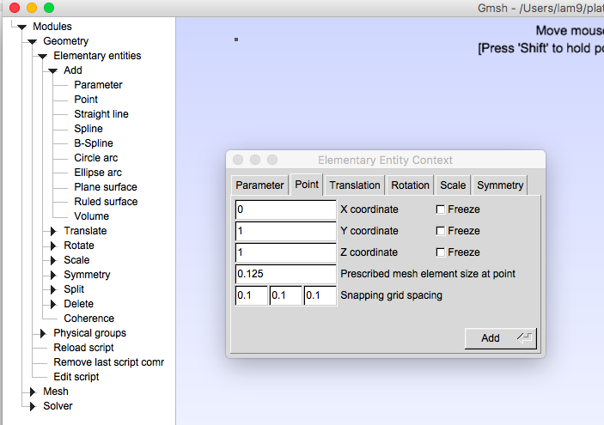
Open gmsh, then File-> new
Go to Geometry-> Elementary entities -> Add -> Point
Make points at (0,1,1), (0,-1,1), (0,-1,-1) and (0,1,-1) with Prescribed mesh element size set to 0.0625.
Click Add for each point.

Slide 6
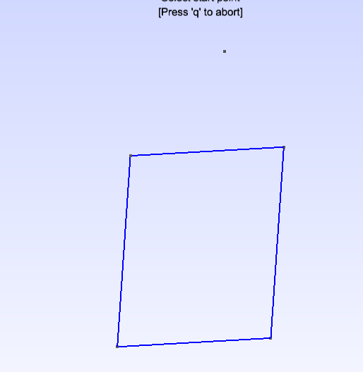
Connect the points with lines
Go to Geometry-> Elementary entities-> Add-> Straight Line
Left click one point and then the next to make a line.
Repeat for all 4 sides.
Left click and drag to rotate the image in 3D.

Slide 7
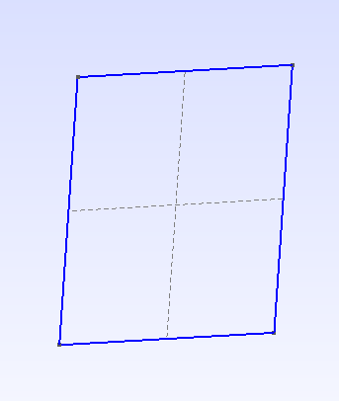
Make a surface from the square
Geometry-> Elementary entities -> Add->Plane Surface
Left click a line to illuminate the hole square.
Press e to end selection.
A grid should appear over the plane.

Slide 8
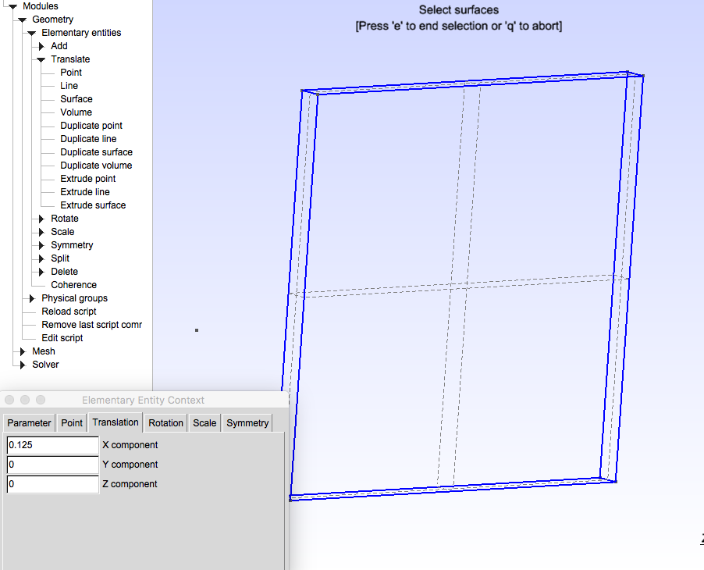
Extrude to 3D plate
Geometry-> Elementary entities -> Add -> Translate -> Extrude surface
Extrude 0.125 in x-direction.
Left click grid so it’s red.
Press e to end.
This will make plate 2 elements thick.

Slide 9
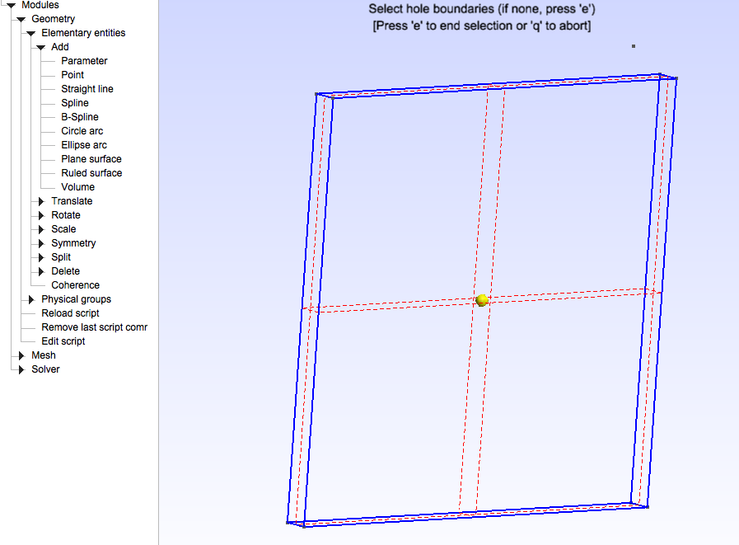
Make a volume in the frame
Geometry-> Add -> Elementary entities -> Add -> Volume
Select dashed grid lines so the glow red, click e to end.

Slide 10
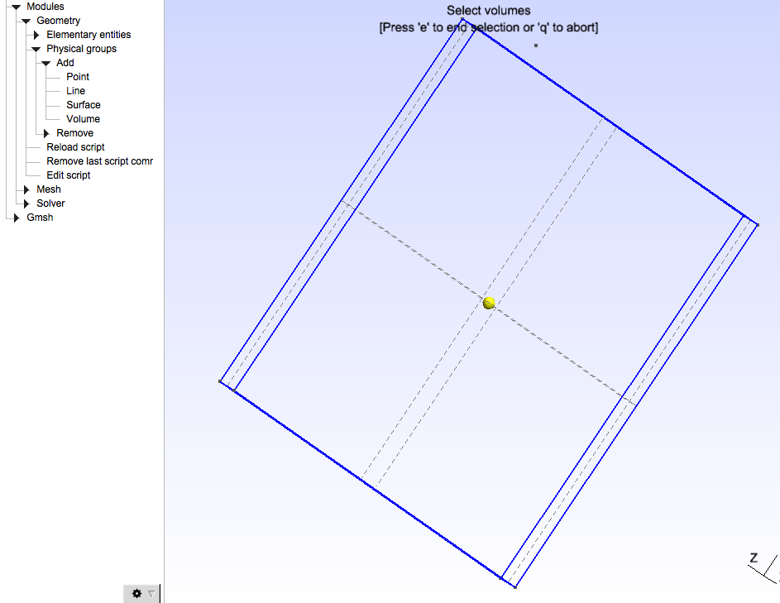
Add a physical group that is the volume
Geometry->Physical Groups -> Add -> Volume
In the popup box, name your mesh and use automatic numbering.
Left click the yellow dot in the middle of box.
Press ‘e’ to end.

Slide 11
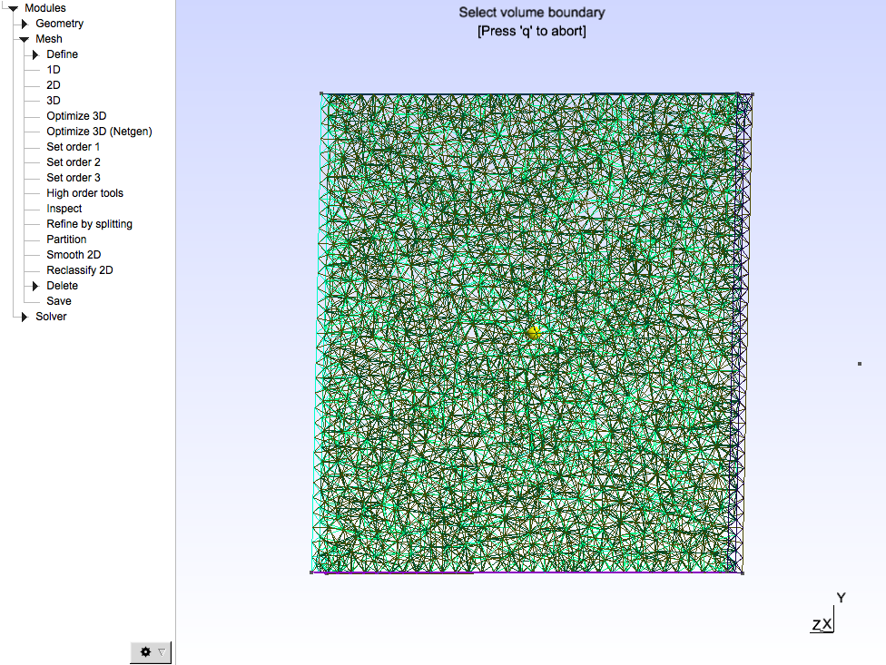
Make the mesh
Mesh -> 3D
File -> save mesh
The above will save the mesh of the physical group as group_name.msh. This leaves only the 3D mesh and no 1D or 2D meshes that libmesh will reject.

Slide 12
input3d
In this example, the mesh name is given in the input3d file. [LM: the mesh name also appears in the main.C file, but I think those lines are obsolete, will check].
Re is modified by updating the viscosity accordingly.
Flow ramps up from 0 m/s at t = 0 and moves in the x-direction.

Slide 13
main.C - Translate FE boundary
We made our FE mesh at the origin. We want to shove the plate left so it’s at the beginning of the flow tank.The coordinate_mapping_function does this.
void coordinate_mapping_function(libMesh::Point& X, const libMesh::Point& s, void* /*ctx*/)
{
X(0) = s(0) - 7; // translated 7 units left along x-axis
return;
}

Slide 14
main.C- Target forces
Apply target force at the midline of plate using target_force_function. Applied in band running from -.1 to .1 in z-direction.
void target_force_function(VectorValue<double>& F, const TensorValue<double>& /*FF*/,
const libMesh::Point& X, const libMesh::Point& s, Elem* const /*elem*/,
const vector<NumericVector<double>*>& /*system_data*/, double time, void* /*ctx*/)
{
libMesh::Point s_dump;
double kappa;
s_dump = s; // this is the tether location before translation, note s = [s(0), s(1), s(2)).
s_dump(0) = s(0) - 7; // now the desired location is translated.
// apply tether force only if z-coordinate of original position is within 0.1 of center.
if (abs(s(2)) < .1)
{
kappa = kappa_s;
}
else
{ // no tether force, set tether stiffness to zero.
kappa = 0;
}
F = kappa * (s_dump - X); // Note x is actual position, s_dump is desired position
return;
}

Slide 15
main.C - stress tensor functions
We want the middle of the plate to have a different stiffness than the ends.
void PK1_dev_stress_function(TensorValue<double>& PP, const TensorValue<double>& FF,
const libMesh::Point& /*X*/, const libMesh::Point& s, Elem* const /*elem*/,
const vector<NumericVector<double>*>& /*system_data*/, double time, void* /*ctx*/)
{
double mu;
// lines below apply one stiffness value to middle, and the rest gets another stiffness
if (abs(s(2)) < .25)
{
mu = mu_stem;
}
else
{
mu = mu_leaf;
}

Slide 16
main.C - stress tensor functions
Repeat for dilation stress function.
void PK1_dil_stress_function(TensorValue<double>& PP, const TensorValue<double>& FF,
const libMesh::Point& /*X*/, const libMesh::Point& s, Elem* const /*elem*/,
const vector<NumericVector<double>*>& /*system_data*/, double /*time*/, void* /*ctx*/)
{
double mu;
double beta;
// lines below apply one stiffness value to middle, and the rest gets another stiffness
if (abs(s(2)) < .25)
{
mu = mu_stem;
beta = beta_stem;
}
else
{
mu = mu_leaf;
beta = beta_leaf;
}

